Slide 1
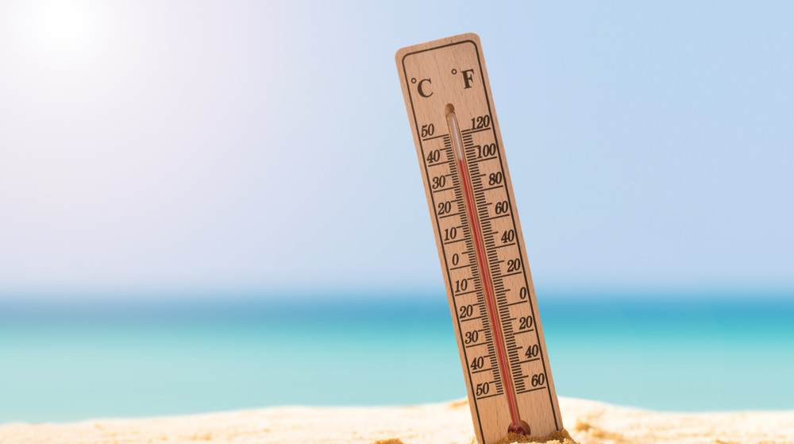
Global Temperature Analysis
Bharadwaj Munugoor, Hemanth Vadlamani, Angela Long, Brendon Peters

Slide 2

Introduction
Data describes Average Temperature for countries around the world with dates ranging from year 1743 to 2013
There are a total of 243 countries represented in the data set
There are total of 577,462 entries in the data set
The Average Temperature is measured in Celsius
There is a column describing the Uncertainty in Average Temperature which is also measured in Celsius

Slide 3
Questions The Data Can Address
How has the global average land surface temperature changed over time?
1
What are the regional and seasonal variations in land surface temperatures across different cities?
2
Are there any emerging trends or patterns in temperature and extreme weather events?
3
Are there differences in temperature trends between urban and rural areas?
4
How have temperature trends varied between different latitudes and longitudes?
5
Are there any specific years or periods that show a more significant increase in temperature?
6
How does the temperature change in cities with higher levels of industrialization compared to places with lower levels?
7
Are certain regions experiencing more significant changes in temperature than others?
8

Slide 4
Our Target Entity and Audience
Target Entity: Environmental Defense Fund (EDF)
United States based nonprofit environmental advocacy group that is known for its work on issues including global warming, human health, oceans, and etc.
Targeted Audiences:
Environmental policymakers
Researchers
Donors/Funders
Governmental Agencies
Corporations
Media Outlets
The general public that are concerned with environmental conservation and protection.

Slide 5

Hypotheses
Temperatures in North America are rising at an exponential rate and will continue to rise in the same pattern since 2000
The Average Temperature in the United States is less compared to the rest of the world

Slide 6

Limitations of Data
Not all world countries are included
Lots of missing data from 1743-1899
Use of different measuring tools in different time periods
Countries are grouped together, and the temperature can vary largely within a country

Slide 7
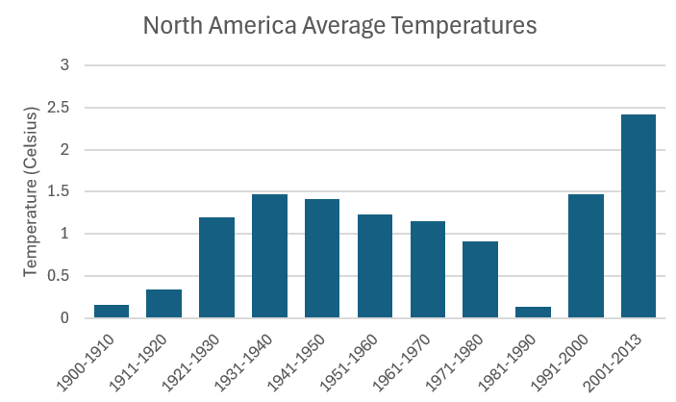
Inconsistencies in Data
32.6k missing values in Average Temperature
31.9k missing values in Average Temperature uncertainty
The date format changes from YY-MM-DD to MM-DD-YY after 1900
Mean from 1900 to 1980: 0.99
Mean from 1981 to 1990: 0.13
Mean from 2001 to 2013: 1.90
Percent change from before 1980 to 1981- 1999: 86%
Percent change from 1981-1990 to after 2001: 1360%

Slide 8
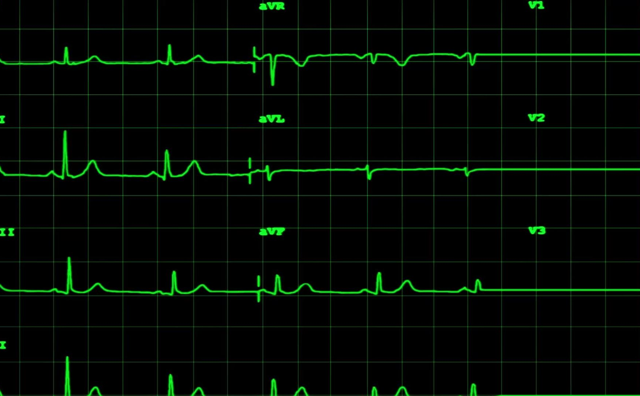
Descriptive Stats of The Data After 1900 (˚C)
Mean Average Temperature of NA: 1.75
Median Average Temperature of NA: 1.64
Standard Deviation of Average Temperature of NA: 10.12
Mean Average Temperature of the World: 8.76
Median Average Temperature of the World: 9.09
Standard Deviation of Average Temperature of World: 4.20

Slide 9
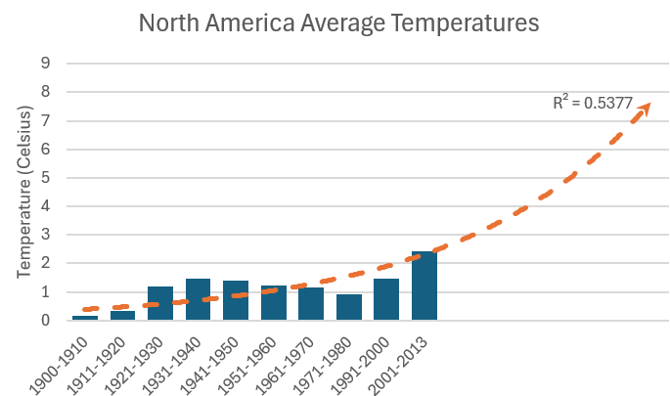
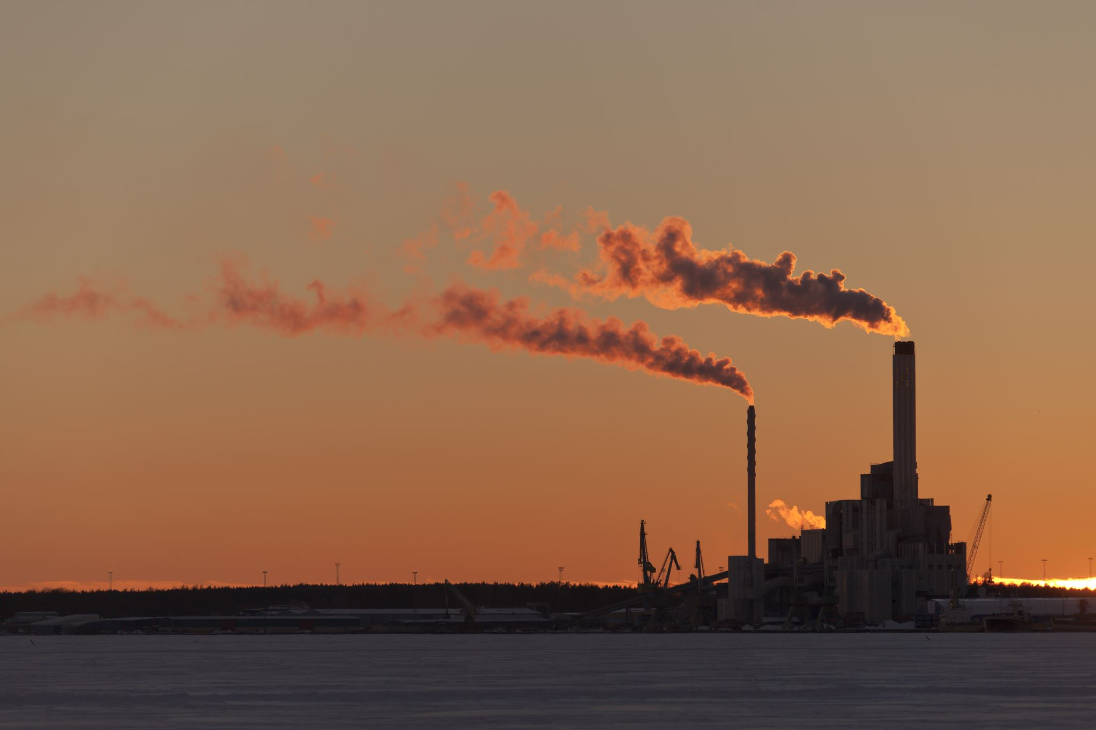
Correlation Analysis
The R squared value is 0.53 which falls in the range of moderately correlated. So, the correlation suggests that as time increases the temperature is expected to increase as well.

Slide 10
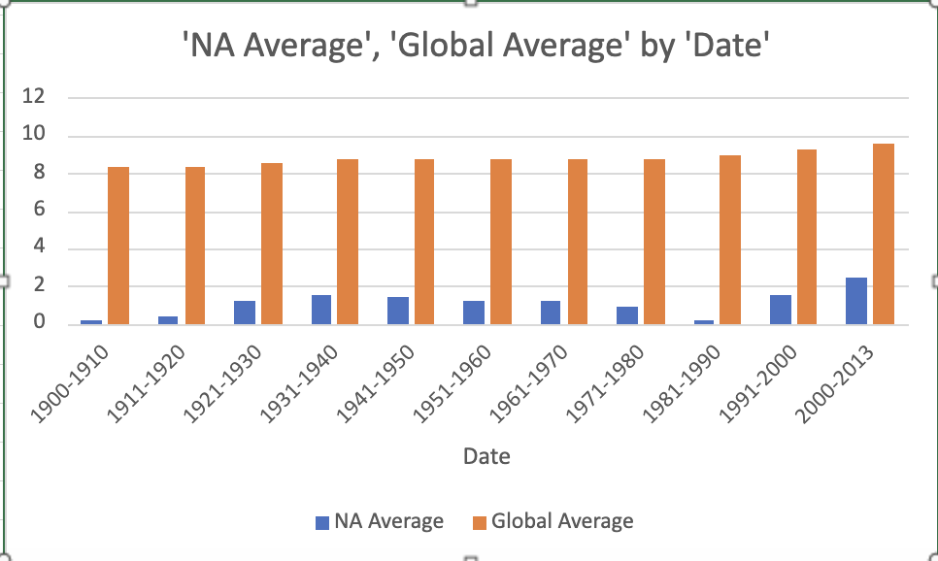
Comparing NA to Global Temperatures(˚C)

Slide 11


Key Insights
Unusual behavior found in the data (large dip in the 1980s)
Explained by Polar Vortex
Exponential trend in NA data
Temperatures rising exponentially
Exponential regression calculations suggest serious implications for the future
NA vs Global
Temperatures are noticeably lower than rest of the world

Slide 12

Conclusion
Temporal Changes: Clear rise in global land surface temperatures post-1980, with exponential trend indicating potential long-term implications
Emerging Patterns: Correlations with extreme weather events highlights emerging temperature trends
Policy and Action: The exponential temperature rise necessitates urgent climate change mitigation and adaptation strategies

